Slide 1


ADVERTISER PACK
2026 / 27
Reach the people
who buy.
For the people who own, run and grow UK small and mid-sized businesses.
SMARTSME.CO.UK
COGENT MULTIMEDIA LTD

Slide 2
WHO YOU REACH
The people you’re getting in front of.
THE LIST TODAY
18,765
named business leaders subscribed to the newsletter.
Smart SME goes to founders, managing directors, directors and managers of UK businesses with under 250 staff, in every sector.
41,671
average monthly visits to the Smart SME website.
WHAT THEY BUY
Business software, AI and IT services
43.9%
average open rate against an industry average of 20%.
Business finance, lending and payments
Accountancy, tax and legal services
HR, payroll and recruitment
Insurance and business protection
Marketing, sales and ecommerce tools
5.60%
average click rate against an industry average of 2%.
SMART SME · WHO YOU REACH
2 / 7
Notes:
Subscribers: Mailchimp, subscribed members on 20 Oct 2026. Open and click rates: pooled across all 16 issues sent to this list. Visits: GA4 sessions, 2026-09-20 to 2026-10-19.

Slide 3
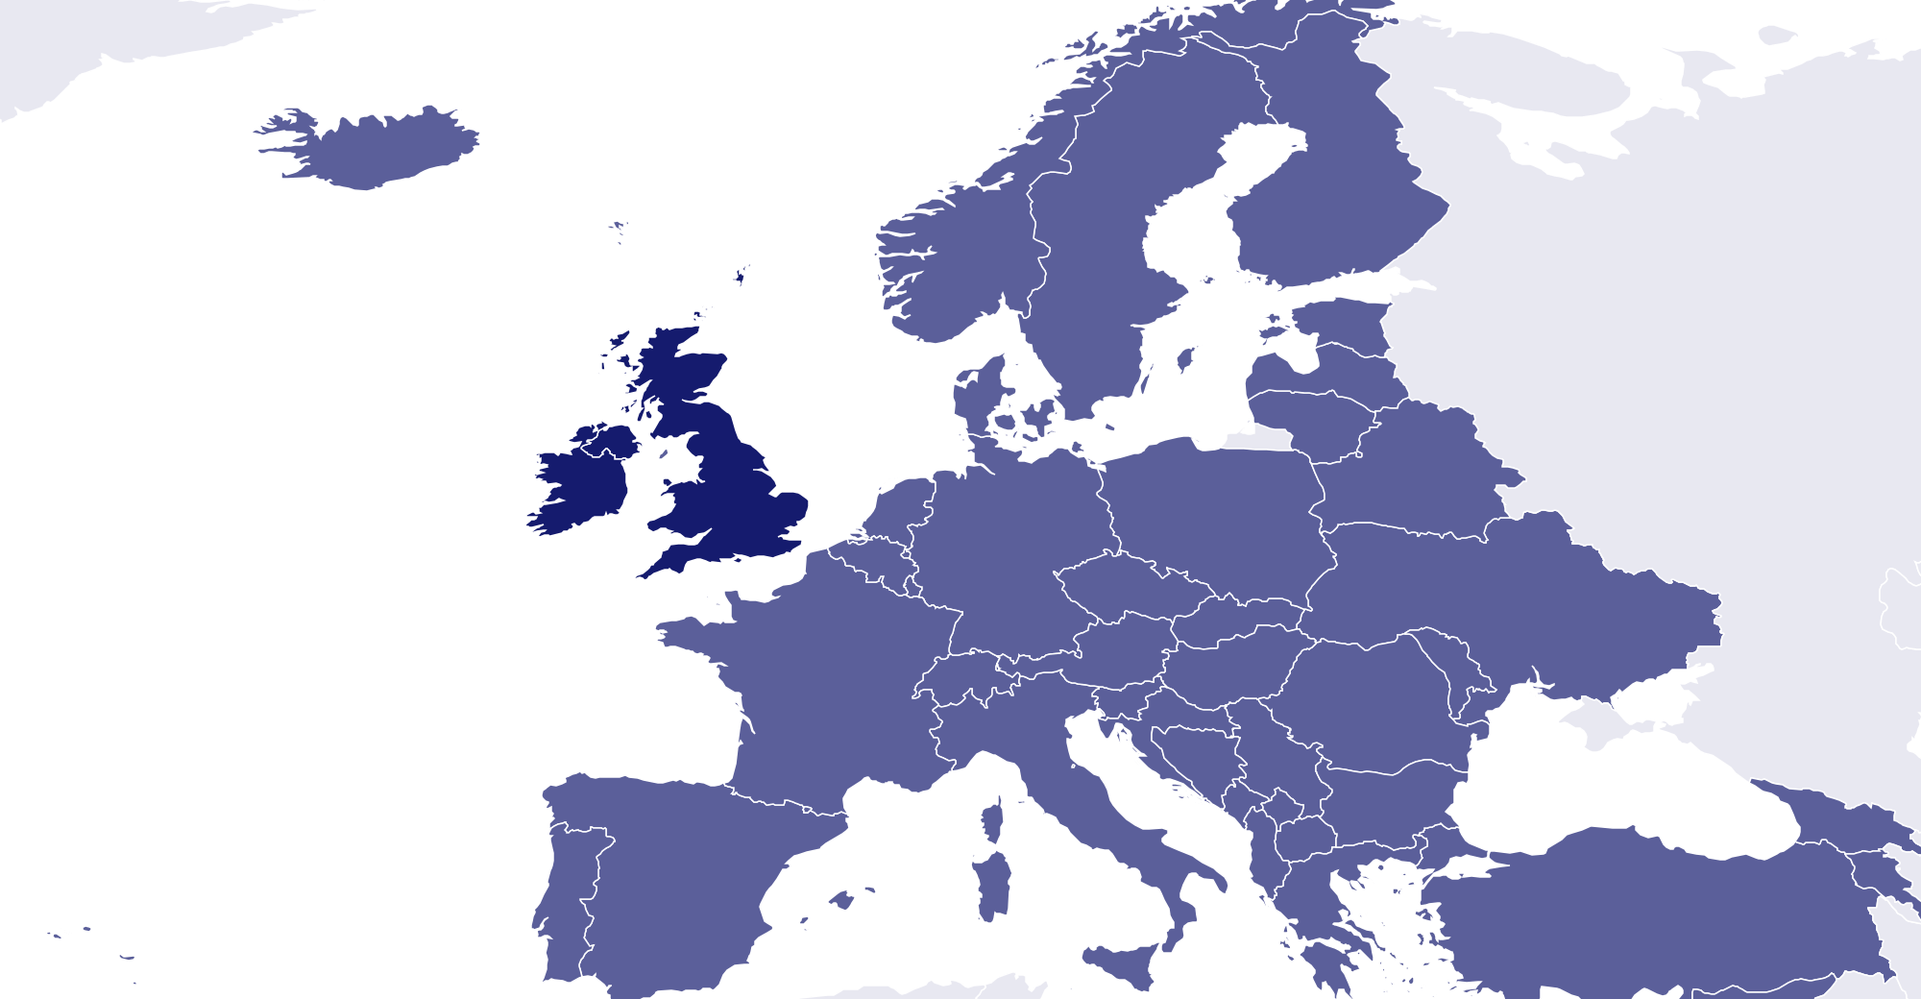
WHO READS
Who reads Smart SME
75% are owners, founders or directors.
45%
30%
20%
5.0%
WHERE THEY ARE
Owner, founder or MD
Director
Manager
Other staff
MOST COMMON ROLES
Managing director
22%
Founder or owner
18%
Operations director
9.0%
Finance director
9.0%
Sales or commercial director
8.0%
General or office manager
7.0%
95%
3.0%
2.0%
UK and Ireland
Europe
Rest of world
COMPANY TURNOVER
SECTOR
STAFF
Under £1m
30%
Professional services
22%
1 to 9
28%
£1m to £5m
32%
Manufacturing
18%
10 to 49
38%
£5m to £25m
24%
Retail and ecommerce
14%
50 to 249
27%
£25m to £100m
10%
Construction and trades
13%
250 or more
7.0%
Over £100m
4.0%
Hospitality and leisure
10%
SMART SME · WHO READS
3 / 7

Slide 4
WHAT YOU CAN BUY
Four ways in.
Every format is digital. Our subscribers have requested to receive content from brands who are able to help their business.
Website banners
Sponsored newsletter content
970×250
300×250
Your brand across the whole site.
Sponsored
Your story in our Monday Briefing, next to our editorial and labelled as sponsored.
HOW A BOOKING RUNS
728×90
01
You tell us what channels you want to use.
970×250 · 728×90 · 300×250
400 words · logo · one link
02
We confirm format, date and price in writing.
03
You send artwork, or copy and we build it.
Newsletter sponsorship
Solus email
04
You approve it before anything goes out.
Sponsor
05
We send the report on your campaign alone.
Your brand as the named sponsor of every issue of our Monday Briefing.
Your email
Your own email, sent to our subscribers. Nobody else in it.
Banner
Per issue, or sponsor a series
We build it, or send finished HTML
SMART SME · WHAT YOU CAN BUY
4 / 7

Slide 5
RATES
Build a campaign.
FORMAT
ONE
THREE
SIX
EMAIL
Our team of marketing experts can work with you to build bespoke campaigns to fit your advertising goals and strategies.
All marketing options are built to send our audience straight to your website with one easy click.
Whatever you chose, it’s designed to deliver traffic to you.
Eshot
£1,000
£750
£500
Your message alone, nobody else in it
EACH
EACH
Newsletter sponsorship
£800
£600
£400
Named sponsor of the Monday Briefing
EACH
EACH
CONTENT
Sponsored article
£200
£150
£100
On the website and in the newsletter
EACH
EACH
DISPLAY
ONE MONTH
THREE MONTH
SIX MONTH
Homescreen Pop-Up
£1,200
£2,700
£3,600
Pops up after 6 seconds
TOTAL
TOTAL
Billboard, 970×250
£900
£2,100
£3,000
TALK IT THROUGH
Top of the homepage
TOTAL
TOTAL
jb@smartsme.co.uk
Leaderboard, 728×90
£600
£1,200
£1,800
Across the site
TOTAL
TOTAL
MPU, 300×250
£400
£800
£1,200
Sidebar button
TOTAL
TOTAL
All rates exclude VAT
SMART SME · RATES
5 / 7

Slide 6
WHAT RESULTS YOU GET
The numbers
you get back.
Statistics
All numbers are an average
EMAIL CAMPAIGN
Delivered
Inboxes it actually reached
18,765
Within 7 days of your campaign finishing, you’ll receive a full performance report showing impressions, open rate and click-throughs to your website.
Unique opens
People who opened, counted once
43.9%
Unique clicks
People who clicked, counted once
5.6%
Click to open
Of those who opened, who then clicked
12.8%
Unsubscribes
Off the list after your send
0.07%
ON THE SITE
Monthly Total Visits
Total impressions on your content
41,671
WHEN YOU GET A REPORT
Monthly Unique Visitors
Unique users who saw your content
32,592
Within 7 working days of the send.
SMART SME · WHAT RESULTS YOU GET
6 / 7
Notes:
Delivered is the current list size. Rates pooled across 16 issues. Visits and unique visitors: GA4 sessions and total users, 2026-09-20 to 2026-10-19.

Slide 7
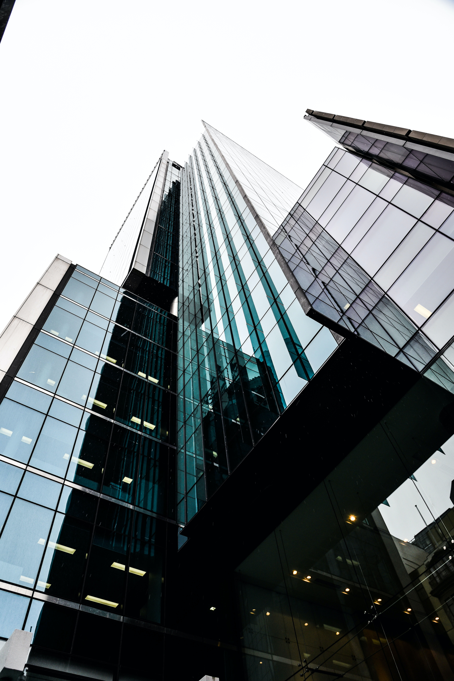
ADVERTISE WITH US
Get in touch.
Tell us who you are trying to reach and what you want it to do, and we will come back with a plan, availability and a price.
ADVERTISING
jb@smartsme.co.uk
SEND US A STORY
smartsme.co.uk/submit-news
SUBSCRIBE FREE
smartsme.co.uk/newsletter
PUBLISHED BY · COGENT MULTIMEDIA LTD, 5 JUBILEE WAY, FAVERSHAM, KENT

